Slide 1

Gokaraju Rangaraju Institute Of Engineering & Technology
Bachupally, Kukatpally, Hyderabad- 500090
DEPARTMENT OF INFORMATION TECHNOLOGY
MAJOR PROJECT ABSTRACT PRESENTATION
On
CREDIT CARD EMBEZZLEMENT USING MACHINE LEARNING
BATCH NO:12
Name Roll Numbers
1. D Karthik 18241A1275
2. N Sai Sujith 18241A1298
3. J Ganesh 18241A1282
4. G Lokesh Reddy 18241A1281
5. V Sharath 18241A12B7
Under the guidance of
Project Guide
Deepika Borgaonkar
Assistant Professor
Head of the Department
Dr. N Ganapathi Raju

Slide 2
UML DESIGNS

Slide 3
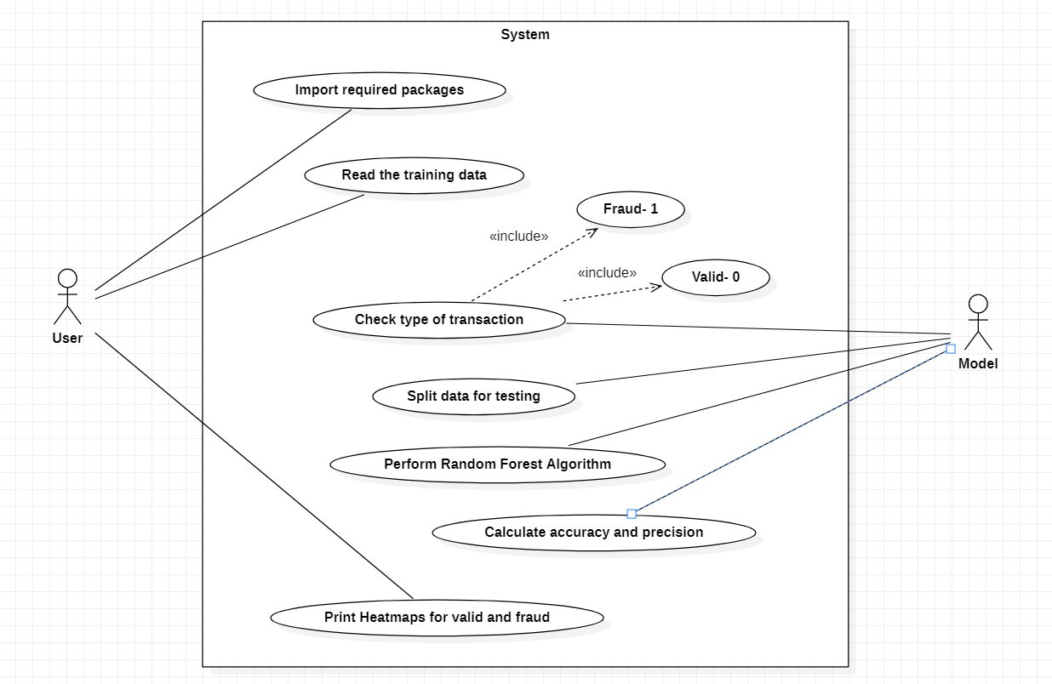
USE CASE DIAGRAM

Slide 4
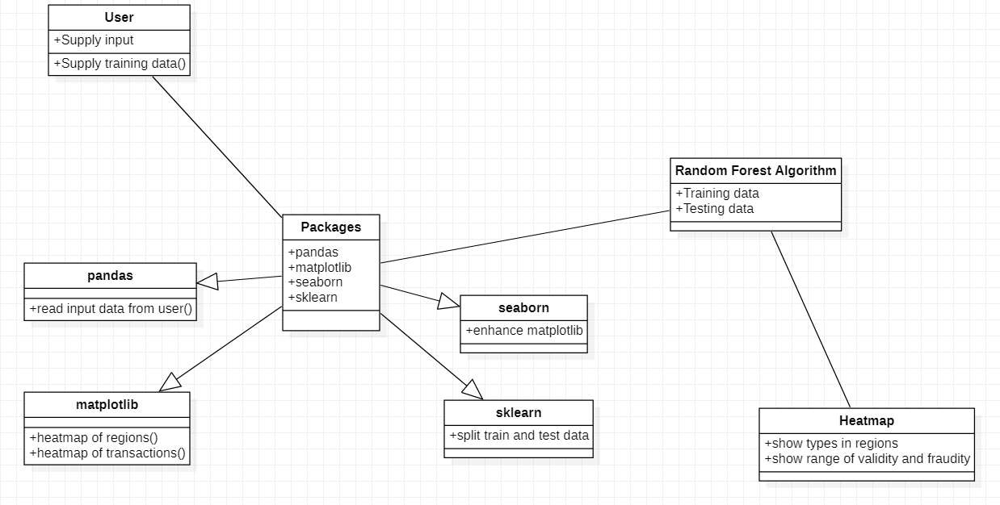
CLASS DIAGRAM

Slide 5
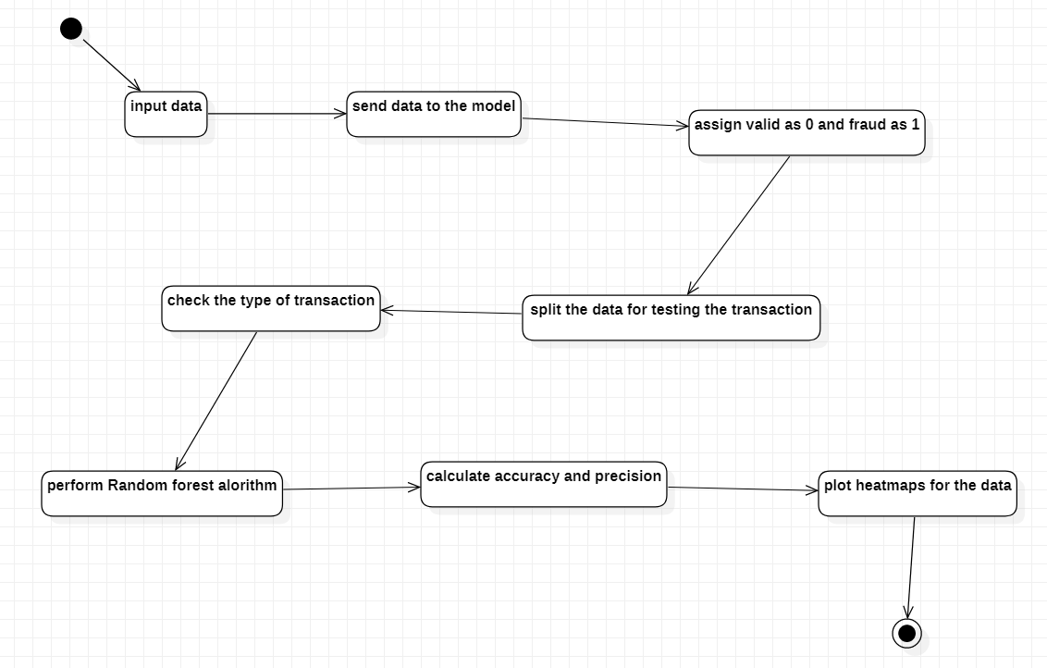
STATE CHART DIAGRAM

Slide 6
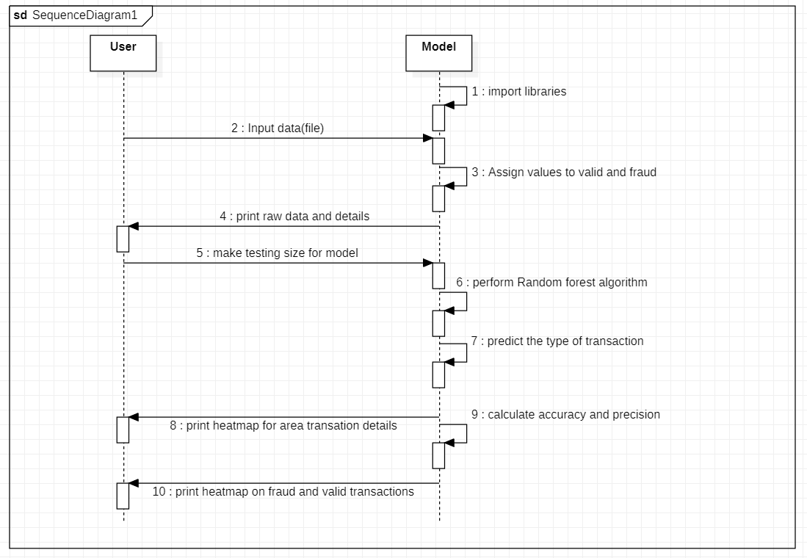
SEQUENCE DIAGRAM

Slide 7
ALGORITHM

Slide 8
Model
Training data
Label the fraudity index
Testing data split
Perform Random Forest Algorithm
Calculate Accuracy and Precision
Print heatmaps between valid and fraud transactions

Slide 9
THANK YOU

